Slide 1
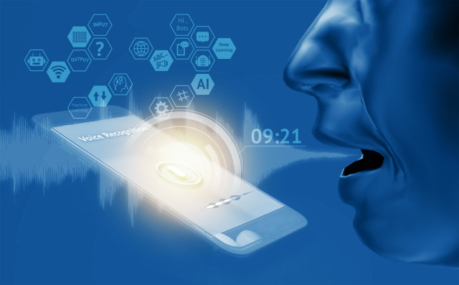
MINI PROJECT PRESENTATION
ON
Voice Based E-mail For Blind People
PRESENTED BY:
ADITYA PAL
AKASH SINGH
PRINCE SHARMA
GUIDED BY:
MR. PANKAJ SHARMA

Slide 2
OUTLINE
Introduction
Motivation
Objective
Methodology
Flow chart of the Project
Python Package / Libraries
Code of the Project
Experimental Result
Conclusion
References

Slide 3
INTRODUCTION
We have created a python project that run on our terminal Which helps Visually impaired people to compose and check there mails through the voice command.
In this project We will use various python modules and libraries.
In the age of social media use of e-mails are vast be it formal or informal work.
There are still millions of peoples Who are not as fortunate as us and this is the beginning of our idea’s.

Slide 4
MOTIVATION
There are nearly 285 million blind people in the world are visually impaired and this number is not just normal and that was our driving force to make this system.
One of the major disadvantage of the existing system is that all the operation are based on the use of keyboard and mouse.
There was a high need of developing a proper system which curbs all the given disadvantages and turn into a simple system.
Simple system means we will develop a system that help to composed and check e-mails without moving a finger.

Slide 5
objective
Create a python program using speech recognition and various other python modules.
Composes a lightning fast mail just using input it gets form the user through voice.
We will also implement the functionality to check the mails present in inbox and we can also set the limits of how many emails we want the program to read.

Slide 6
methodology
Overview:
This project do the following things.
Ask the user for their login credentials.
Provide user two options
Compose
Check inbox
Composed will send the emails
Check inbox show the recent email recived.
All interaction will be though voice only. No use of keyboard and mouse required

Slide 7
methodology
Requirement:
Basic requirement to make this project are
Any python interpreter like spyder , anaconda,
Basic knowledge of modules in python.
Modules should be installed using pip package installer.
Working email id.

Slide 8
flowchart
START
YES
Asking user for login credentials
Ask user for two option
Ask user for receiving mails and message
Compose
Mail sent
Ask user if he/she want to continue
YES
Check mail
Ask user for no.. of mails want to read
Read out mails
NO
Exist

Slide 9
Python package / libraries
speech recognition
gtts
smtplib
imaplib
OS module
pyglet
beautifulsoup
time module

Slide 10
Python package / libraries
speech recognition:
Speech recognition is a machine`s ability to listen to spoken words and identify them.
We can use speech recognition in python to convert the spoken words into text, make a query or give a reply
gtts:
gtts (google text to speech ), a python libraries and CLI tool to interface with google translate with google translate’s text-to-speech API.
Customizable text pre-processors which can, for example, provide pronunciation corrections.

Slide 11
Python package / libraries
Smtplib:
This is simple mail transfer mail protocol, and its module define an SMTP client session object that can be used to send mail to in internet machine with SMTP and ESMTP listener daemon.
Imaplib:
Python`s client side library called imaplib is used for accessing emails over imap protocols
IMAP is an email retrieval protocol which does not download the email.
It just read them and display them.

Slide 12
Python package / libraries
Pyglet:
It provide a object oriented application programming interface for creation of games and others multimedia applications
OS Module:
Its provide a facility to establish the interaction between user and the operating system..
This module provide a portable way of using operating system-dependent
Functionality.
The OS and OS.PATH modules many functions to interact with the file system

Slide 13
Python package / libraries
Beautifulsoup:
It is a python library for pulling data out of HTML and XML files.
Its work with your favorite parser to provide idiomatic way of navigating, searching, and modifying the parse tree. It commonly saves programmers hours or day of work.
Time Module:
Time modules allow to work with time in python.
It allow functionality like getting the current time, pausing the program from executing etc.

Slide 14
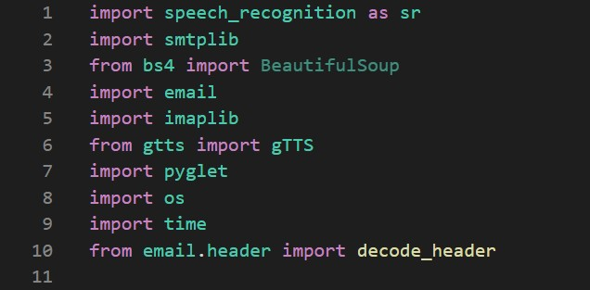
Code of the project
Imported Modules

Slide 15
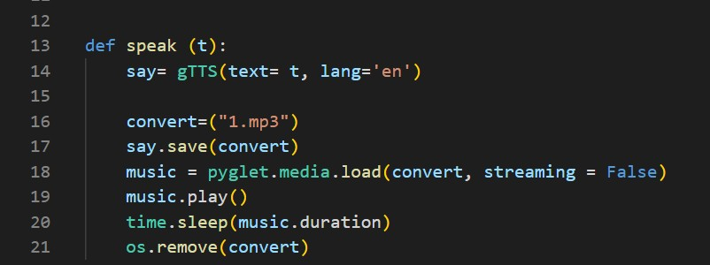
Code for text to speech

Slide 16
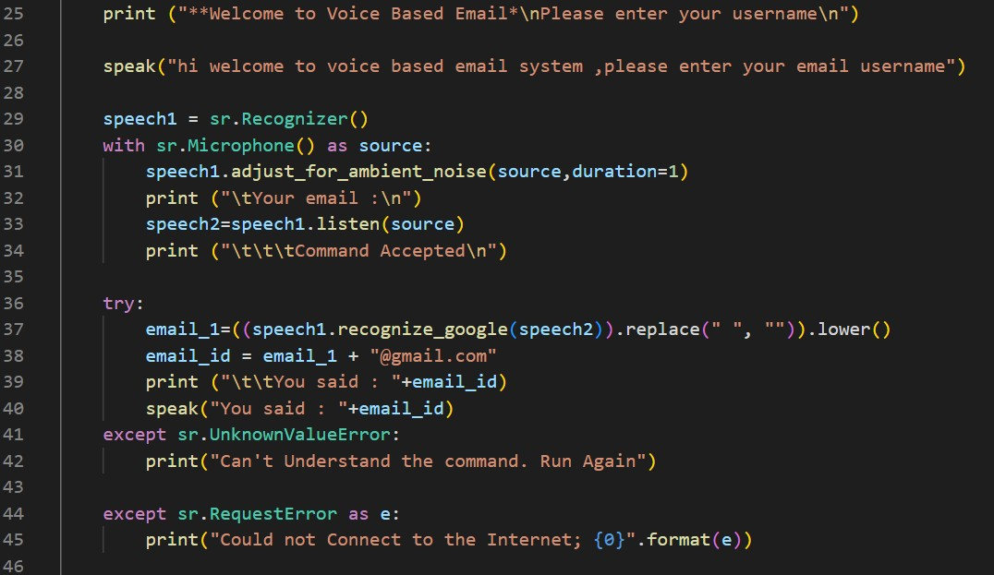
Code for login create details

Slide 17
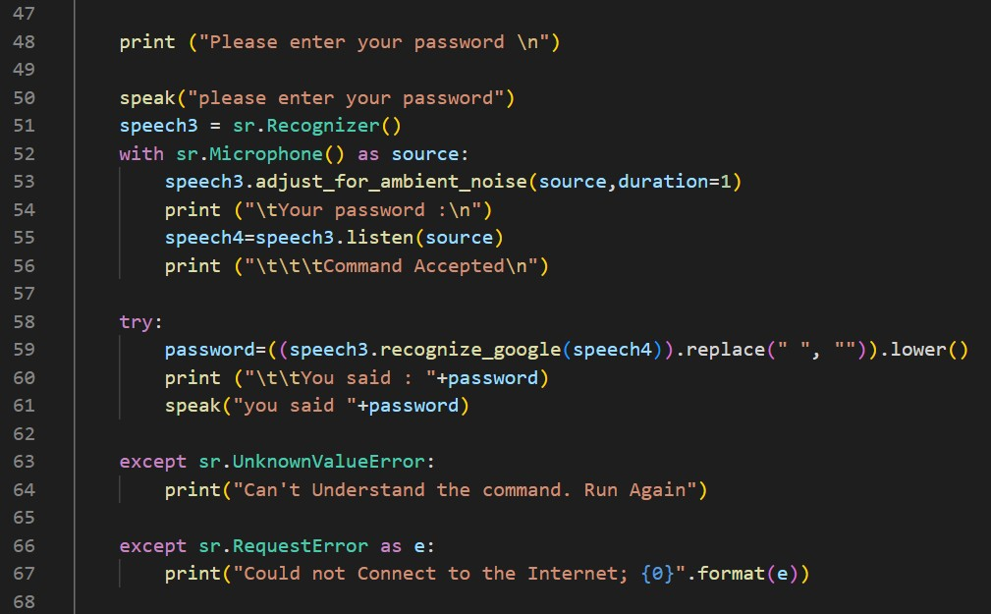

Slide 18
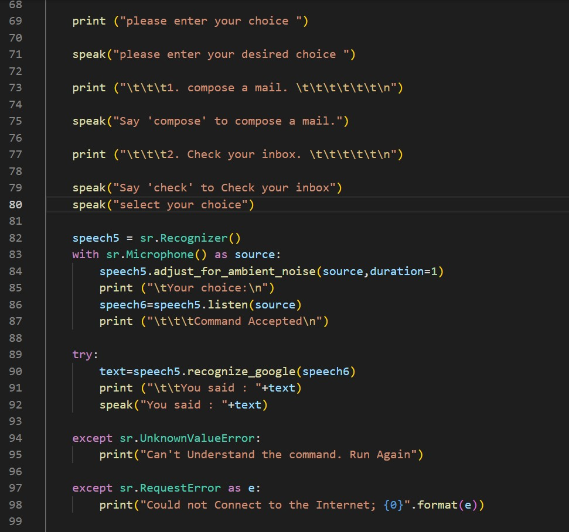
Code for choices

Slide 19
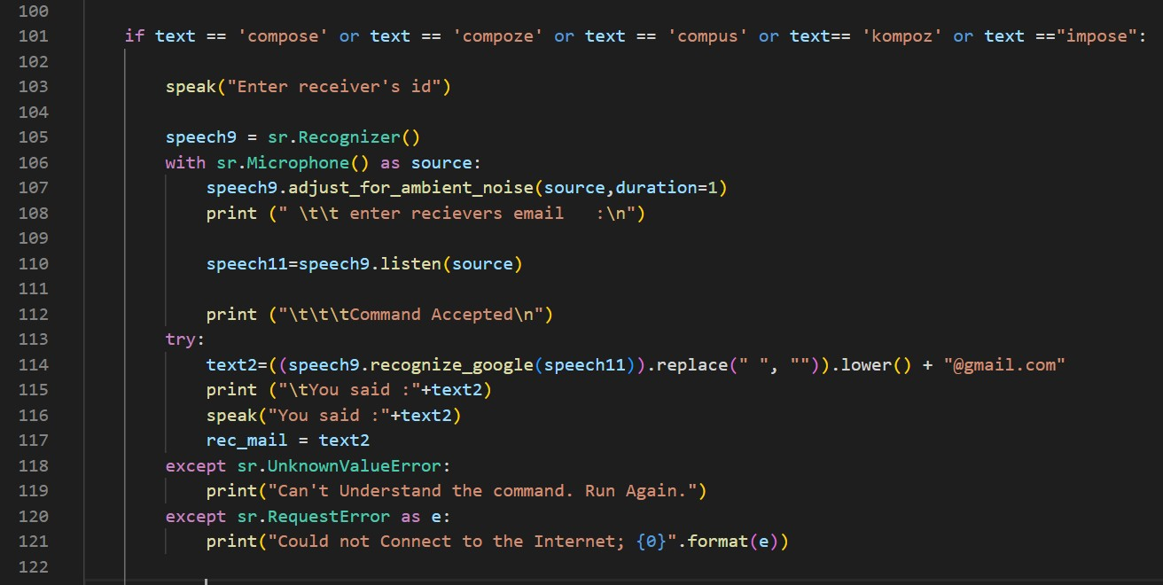
Code for compose and checking inbox

Slide 20
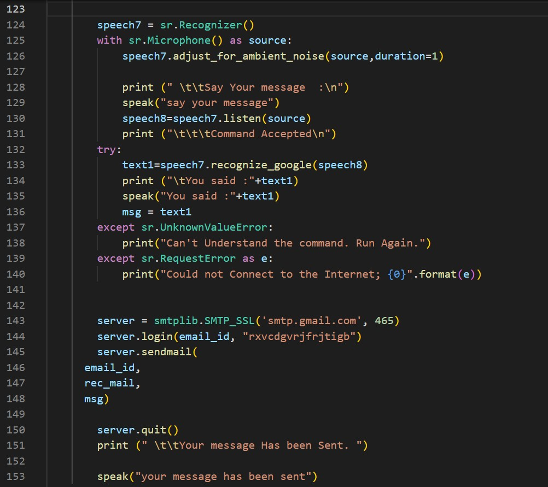

Slide 21
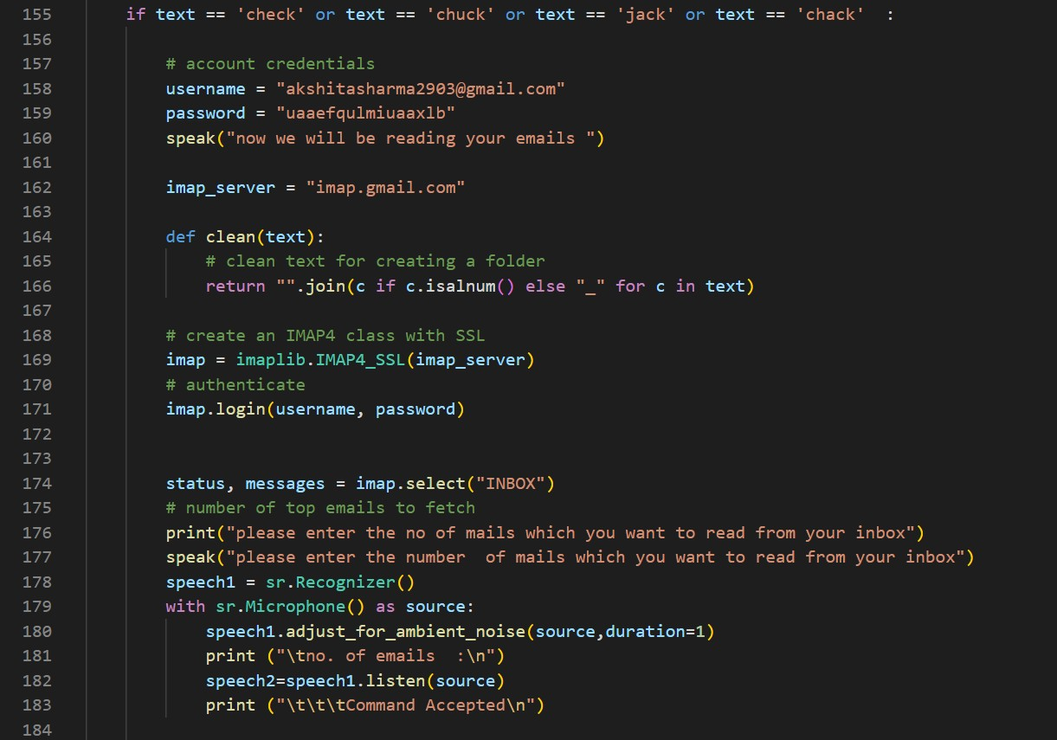

Slide 22
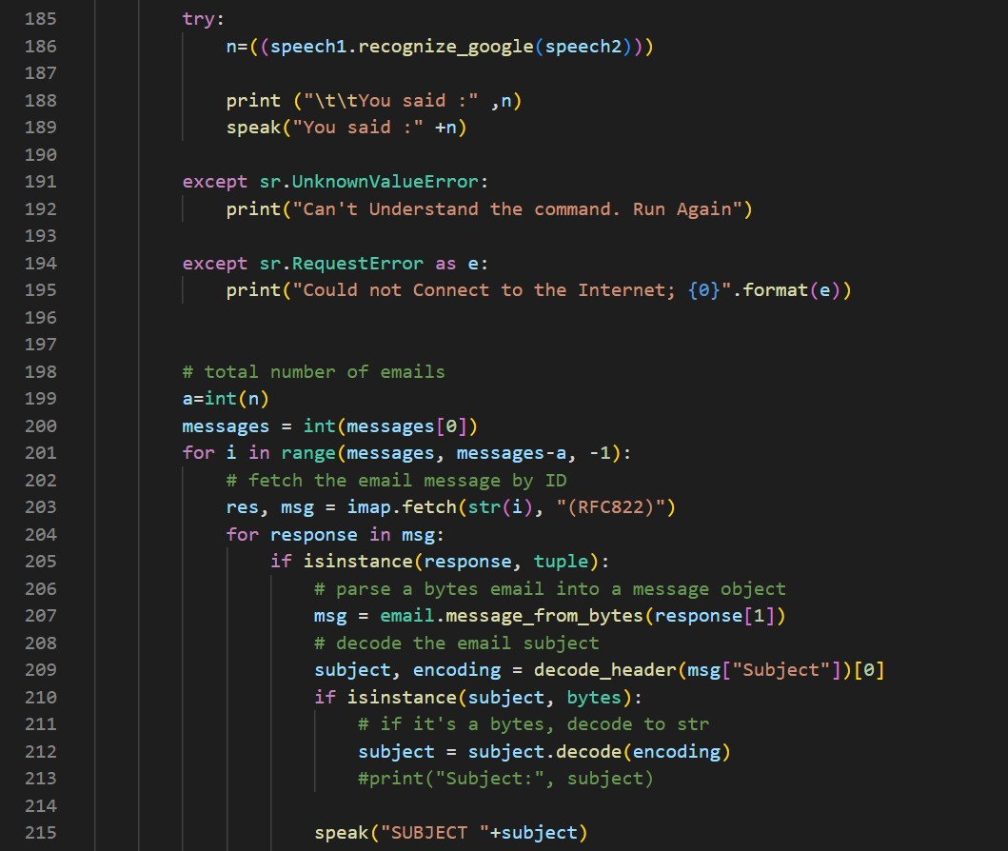

Slide 23
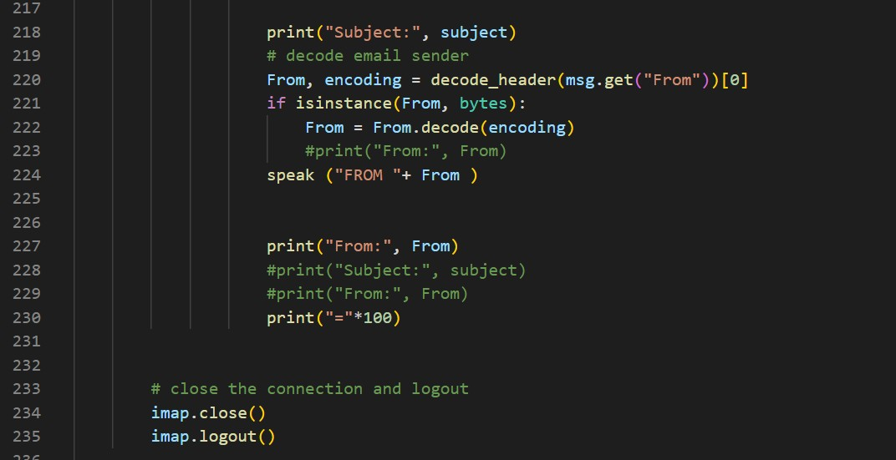

Slide 24
Experimental result

Slide 25
conclusion
The project has a number of advantages and help blind people to send or read emails though voice.
This paper suggests that it will be useful for the community so that people with disabilities to develop on the side of the village.
This project allows people with visual impairments to be quite capable of being a part of the growth of digital India and on their ability to communicate over the Internet and in people's lives easier.
This system overcomes many of the disadvantages of the people down your face when you see how to send and receive email.

Slide 26
REFRENCES
T. Shabana, A. Anam, A.Rafiya, K. Aisha, "Voice based Email System for Blinds", "IJARCCE", Jan i2015.
Jayachandran, K., & Anbumani, P. (2017). Voice based email for blind people. Int. J. Adv. Res. Ideas Innov. Technol., i3(3), i1065-1071.
Guillermo Arturo Hernández Tapia, Ana Lilia Reyes-Herrera . "E-mail management system for blind people in Spanish language". In Interaccióni'17: XVIII International Conference on Human Computer Interaction Cancun Mexico September, i2017.
T. Raman, Audio system for technical reading: Ph.D. Thesis, Cornell University, i1994.
T. Dasgupta and A. Basu. A speech enabled Indian language text to braille transliteration system. In Information and Communication Technologies and Development (ICTD), i2009 International Conference.

Slide 27
THANKS

